Slide 1
GREEN BLOG
BY
ECE CHARMS

Slide 2
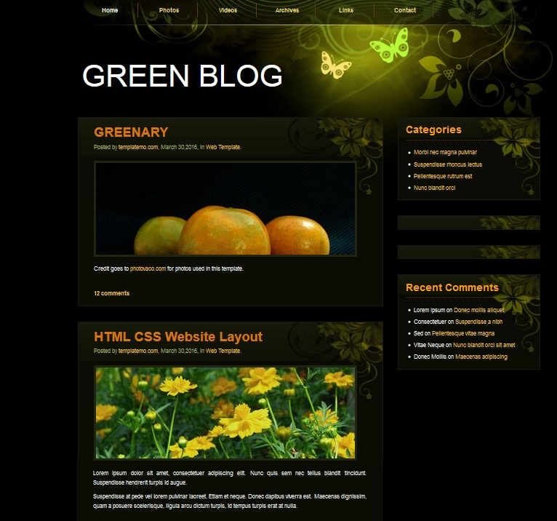

Slide 3
ABSTRACT
In this paper, a model of green urbanism (GU) incorporating the concept of planting of trees and greeneries has been proposed. The GU model mainly attempts to address challenges encountered by dynamically changing cities around the globe due to the reduced number of urban greeneries transforming into built-up areas. A framework has been designed to develop a greenery-based conceptual model (GBCM) towards attaining sustainable healthy liveable (SHL) environment. The model is discussed in terms of greenery-based urban strategies and methodologies to deal with the social and economic contexts particularly in Dhaka city.
In this context, we first revisit the present state-of-the-art of greeneries in Dhaka, then examine whether Dhaka a SHL-city and finally, an attempt has been taken to revive GU in Dhaka to bring a sustainable healthy environment. The model has reconfirmed that greeneries are the roots of adopting green urbanism which could bring a number of fundamental environmental benefits including reduction in energy use, pollution, waste generation, emission of greenhouse gas, impacts on climate and occurrence of natural disasters etc. The model thus developed has an implication on how city planners can adapt a priori approach to ensure sustainable health of populations combating unprecedented social, economic and environmental challenges that make cities unsustainable, unhealthy, and unliveable (3U-cities) due to insufficient greeneries.

Slide 4
Thank you

